Slide 1
Fitness Tracker
Database Management System Project
-by Gaurav Kumar

Slide 2
Presented by: Gaurav Kumar
Roll No : 2301331720023
Branch & Semester : Cyber Security (4th Sem)

Slide 3
Project Description
A web-based Fitness Tracker that allows users to input their Name and Day to retrieve fitness data, including steps taken, calories burned, workout details, and sleep patterns.

Slide 4

Technologies Used
•- Frontend: HTML, CSS, JavaScript
•- Backend: Node.js, Express.js
•- Database: MongoDB
•- Other: Mongoose, Fetch API

Slide 5
Features of the System
1. User Input & Data Retrieval
• Users can enter their Name and select a Day to fetch fitness data.
2. Fitness Data Management
• Stores and retrieves user fitness details, including steps, calories burned, heart rate, and active minutes.
3. Workout & Sleep Tracking
• Displays detailed workout information such as type, duration, distance, and calories burned.
• Tracks sleep data, including total sleep, deep sleep, REM sleep, and sleep score.
4. Dynamic Data Display
• Fetches and presents data in a well-structured modal popup for better readability.
5. Database Connectivity (MongoDB)
• Uses MongoDB to store fitness records and retrieve data efficiently.

Slide 6
System Architecture
1. Client-Side (Frontend) – User Interface
• Built using HTML, CSS, JavaScript.
• Allows users to input Name and Date to fetch fitness data.
• Displays fitness data in a modal popup.
• Handles user input validation and error messages.
2. Server-Side (Backend) – API & Business Logic
• Developed using Node.js and Express.js.
• Handles requests from the frontend and processes them.
• Connects to the database using Mongoose (MongoDB ODM).
• Provides a REST API to fetch user fitness data.
• Includes a server health check endpoint.

Slide 7
3. Database Layer – MongoDB
• Stores fitness records for different users and days.
• Uses a structured User Schema with Name, ID, and daily fitness logs.
• Retrieves and serves fitness details based on user requests.
4. Data Flow in the System
1. User enters Name and Day in the UI and clicks “Submit”.
2. Frontend sends a request to the Node.js backend via Fetch API.
3. Backend processes the request, queries MongoDB, and retrieves fitness data.
4. Data is sent back to the frontend, formatted, and displayed in a modal popup.
5. If errors occur, appropriate messages are shown to the user.

Slide 8
Key Points in Database Design
1. Users are uniquely identified by id.
2. Fitness data is stored in a days object, where each day (Monday, Tuesday, etc.) has its own fitness stats.
3. Nested structure for sleep, workout, and health categories to keep the data structured.
4. Indexing id for faster lookup in MongoDB.
5. Scalable design—new fields can be added easily without restructuring the database.

Slide 9
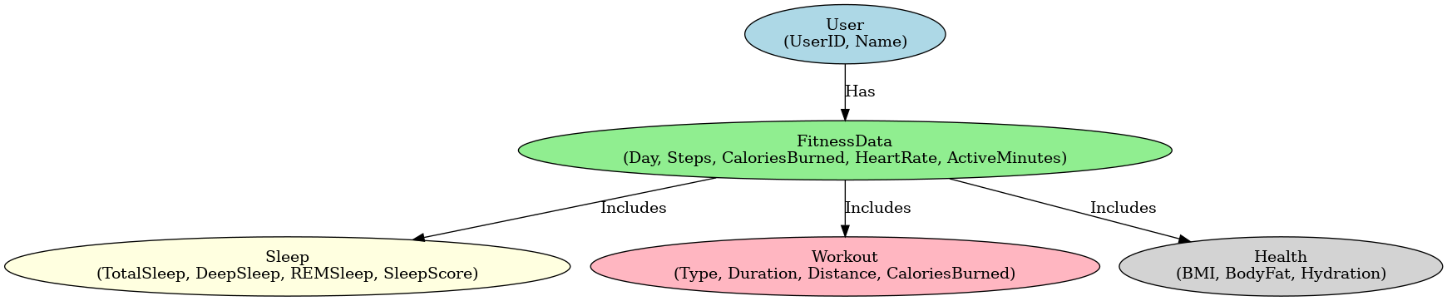
E-R Diagram

Slide 10
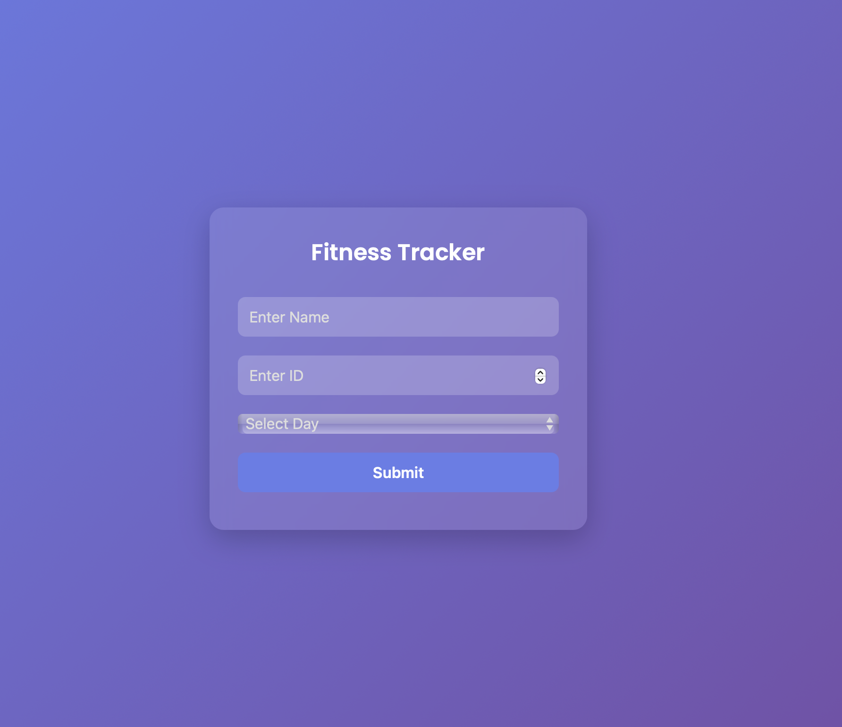
Screenshots of the Application

Slide 11
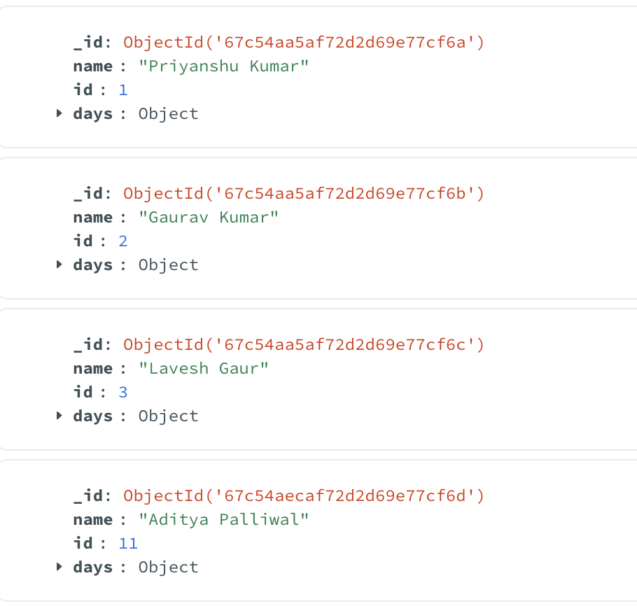
Test with given values
First make sure that server.js is running

Slide 12
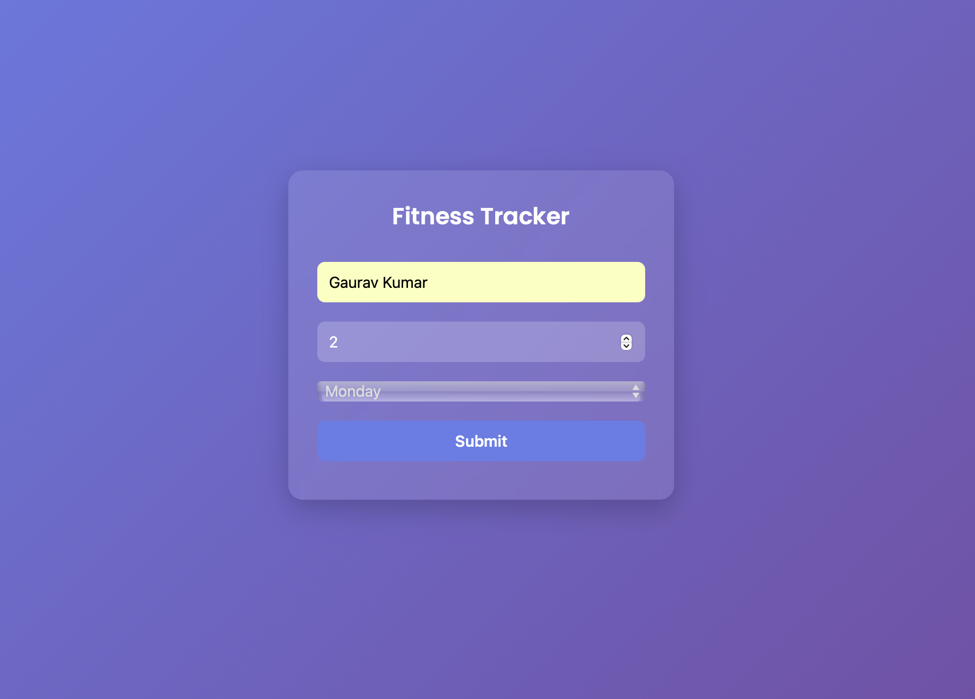

Slide 13
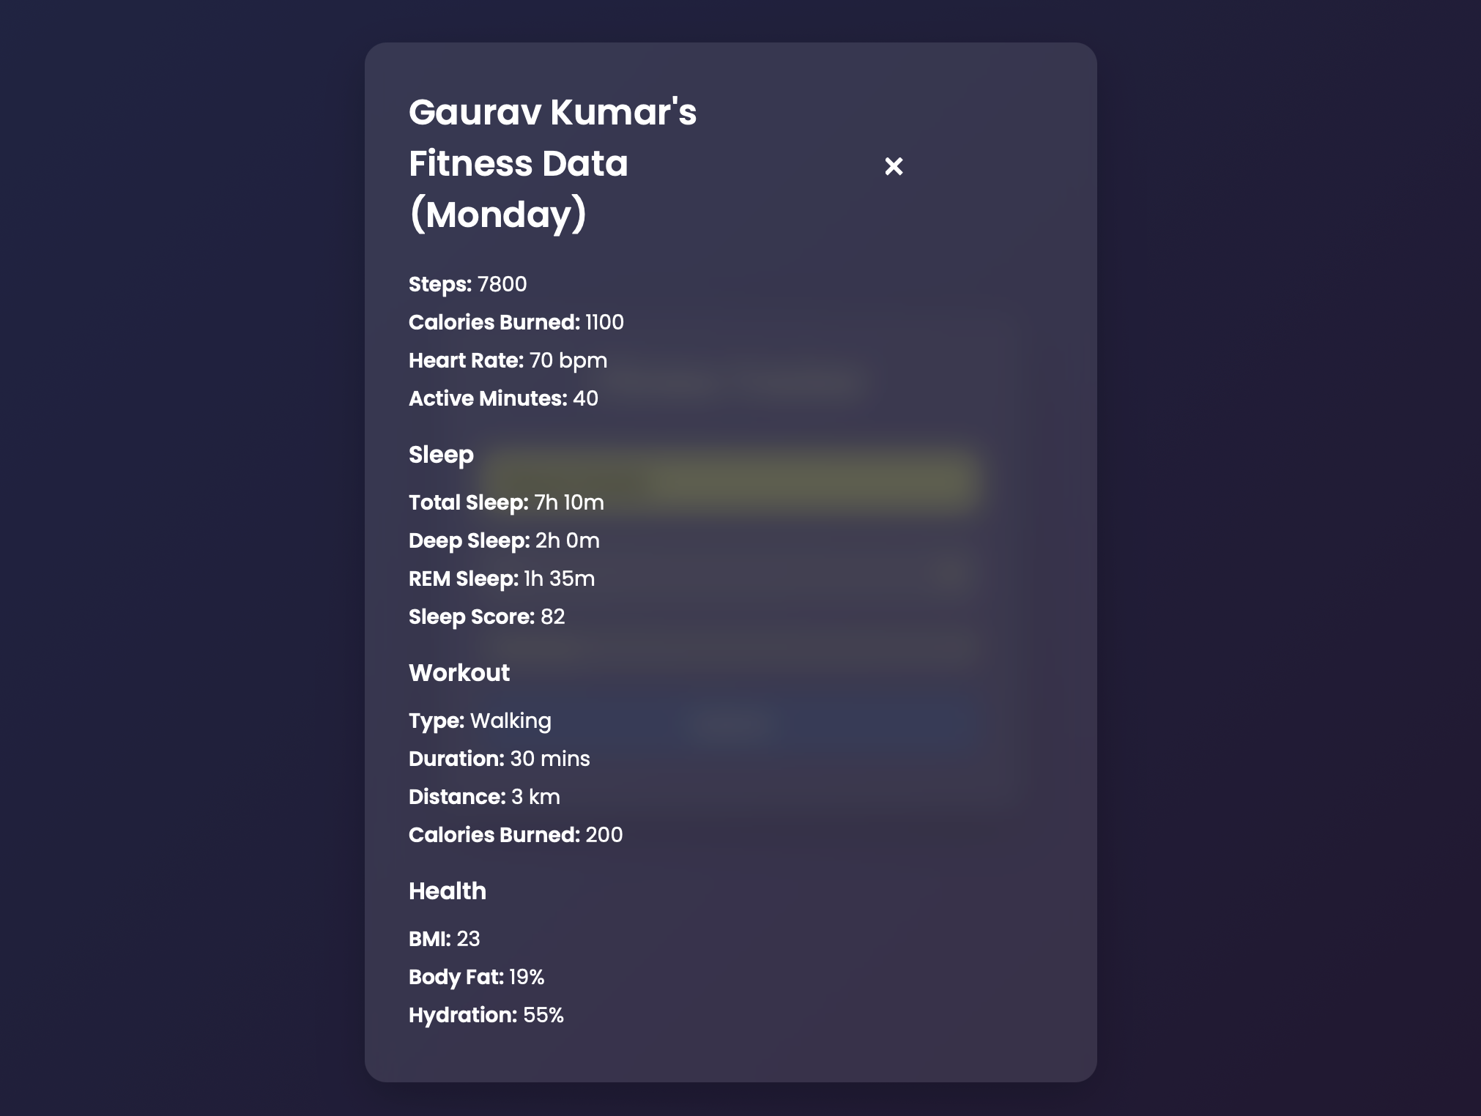

Slide 14
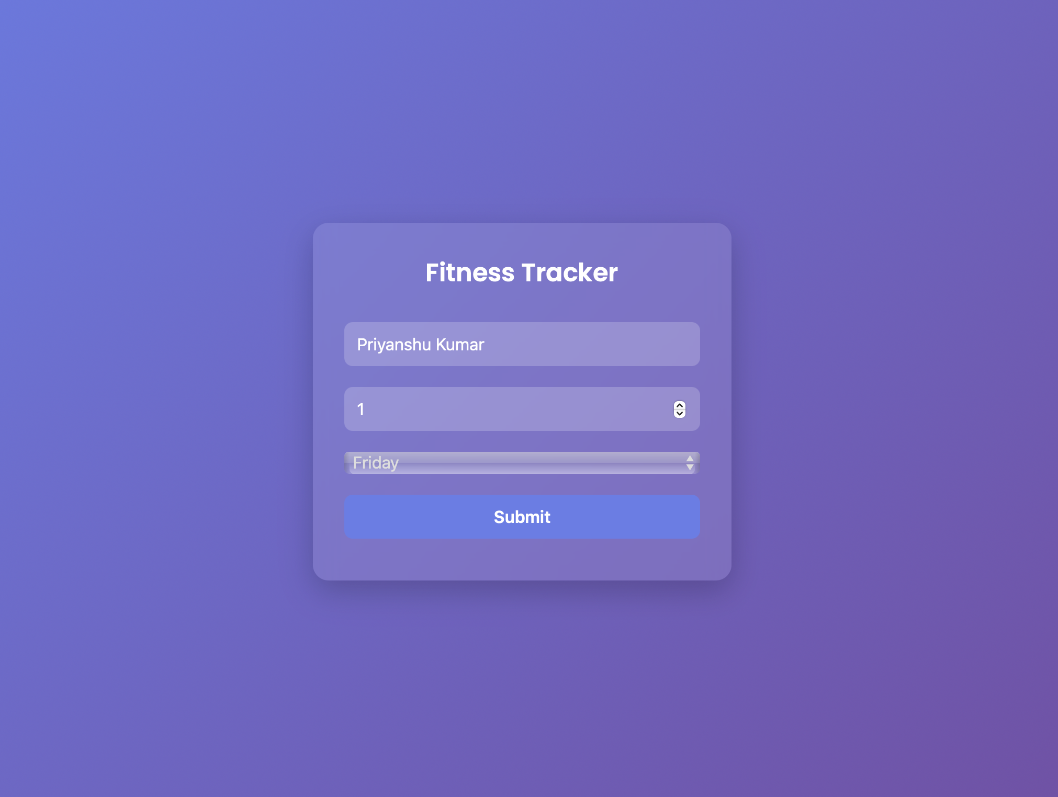

Slide 15
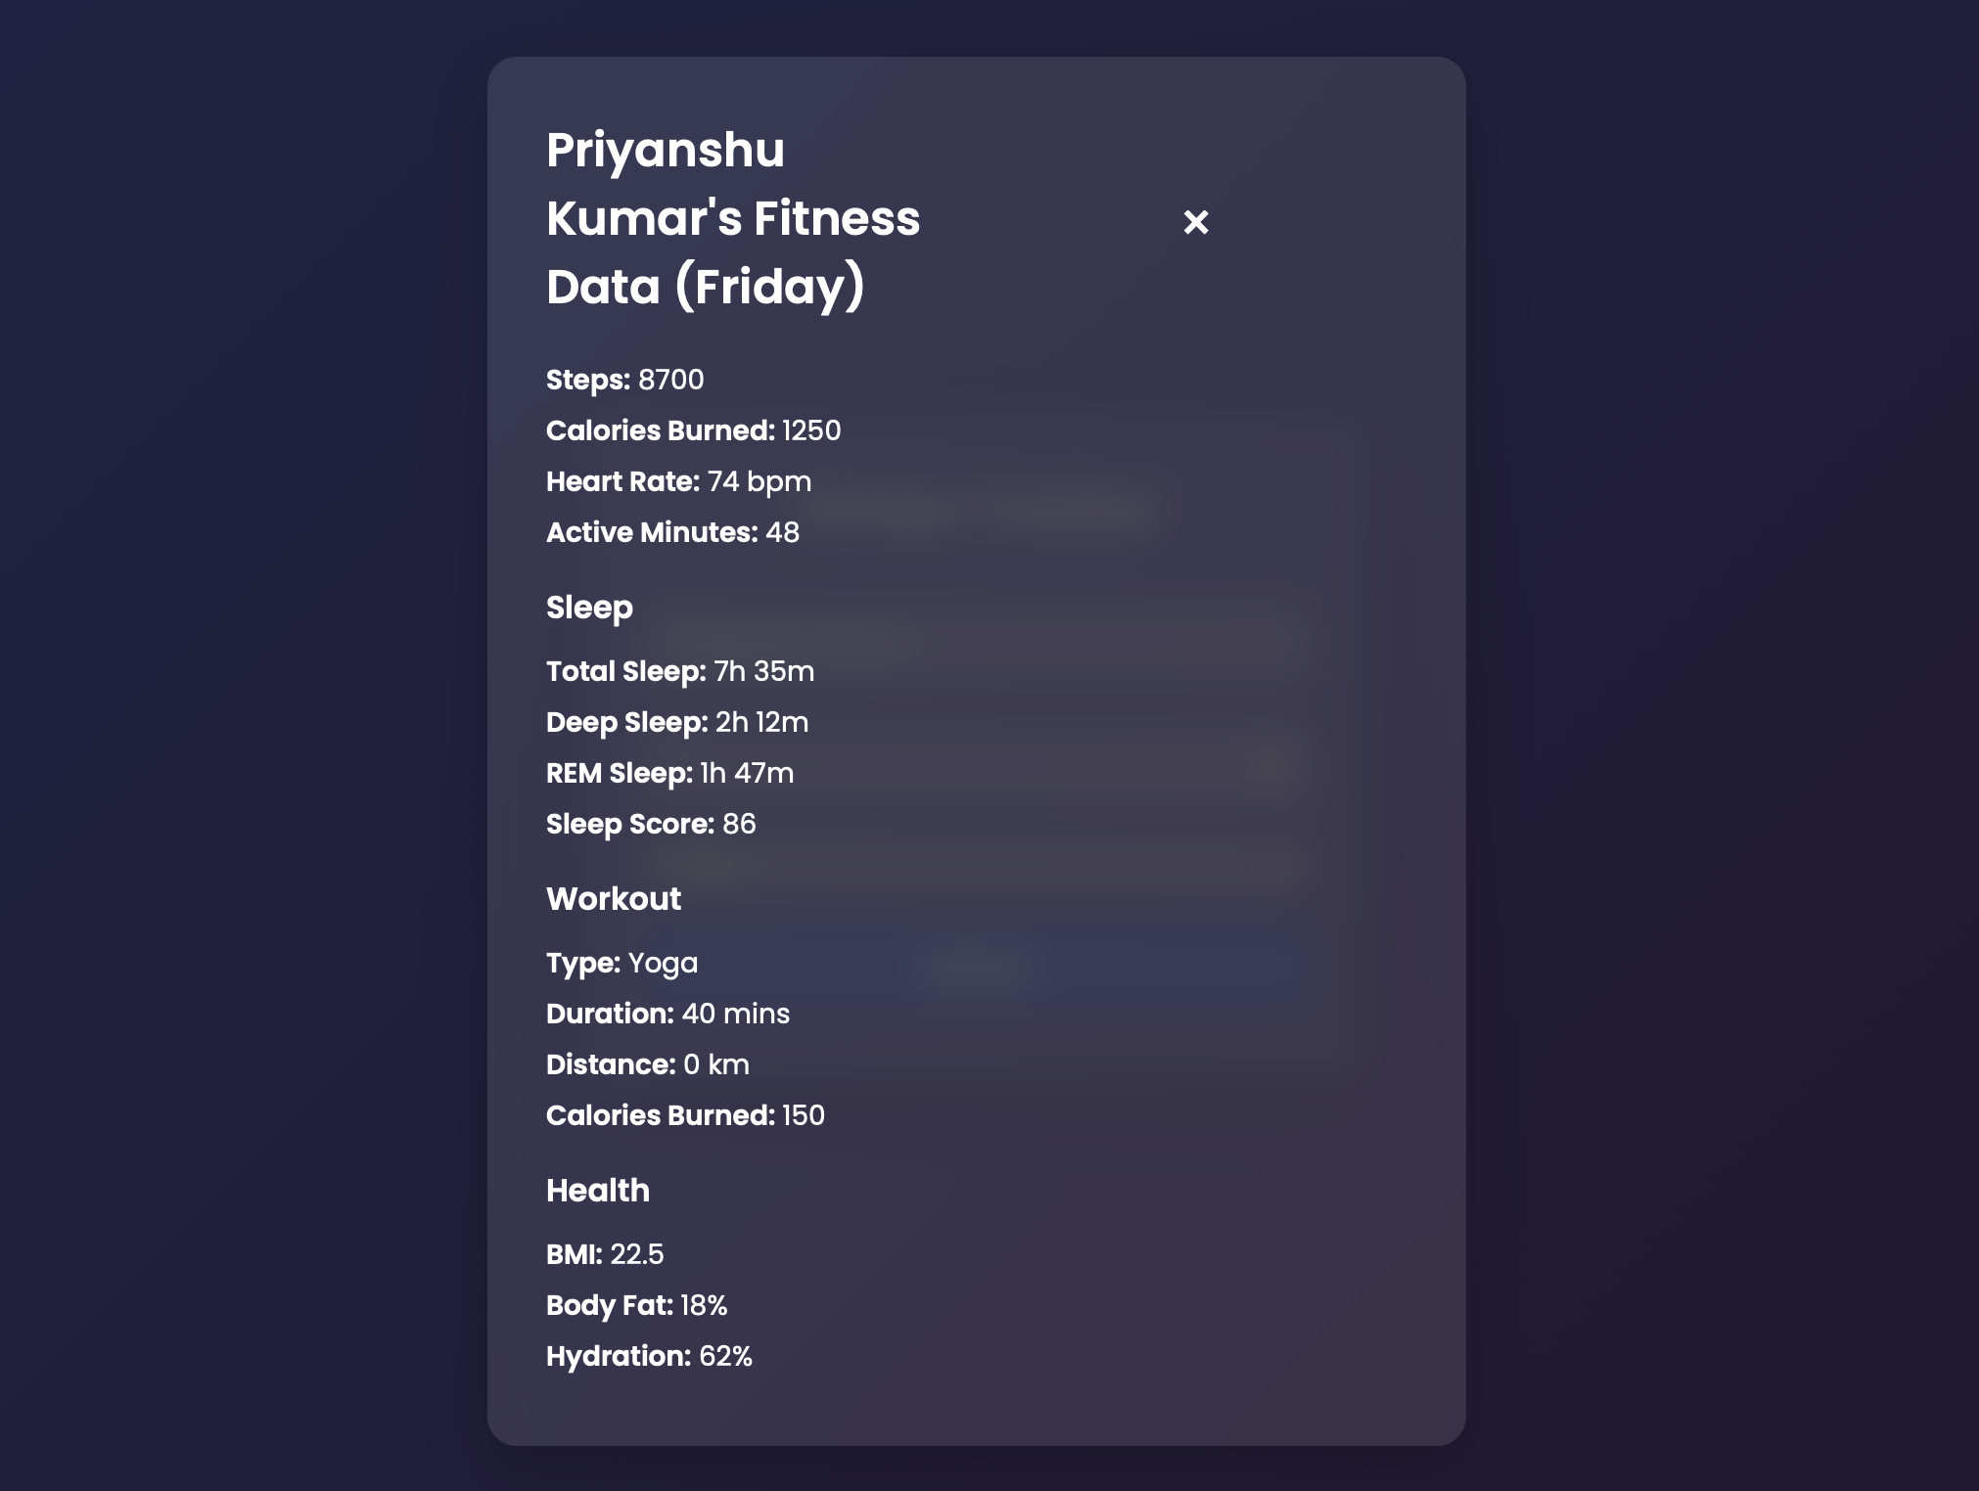

Slide 16
Source code and Dependencies
For source code you can visit my GitHub Repo just following by given link:
https://github.com/orewagaurav/mongodb-nodejs

Slide 17
Challenges Faced !
•- Ensuring real-time database connectivity
•- Handling user input validation effectively
•- Managing asynchronous API requests
•- Implementing a responsive design for different screen sizes

Slide 18
Conclusion
The Fitness Tracker Project is a well-structured web-based application designed to efficiently store, manage, and retrieve user fitness data. By leveraging MongoDB as the database, Node.js with Express.js for backend operations, and a modern frontend with HTML, CSS, and JavaScript, the system ensures a seamless and responsive user experience.
Key features such as real-time data fetching, workout and sleep tracking, user input validation, and a dynamic UI make it a robust and scalable solution. The integration of server health checks and error handling further enhances its reliability.
This project can be expanded in the future by adding user authentication, interactive analytics dashboards, smartwatch API integration, and real-time health monitoring. Overall, the Fitness Tracker Project successfully demonstrates the power of full-stack development in managing fitness data effectively.

Slide 19
Thank You !

